Slide 1
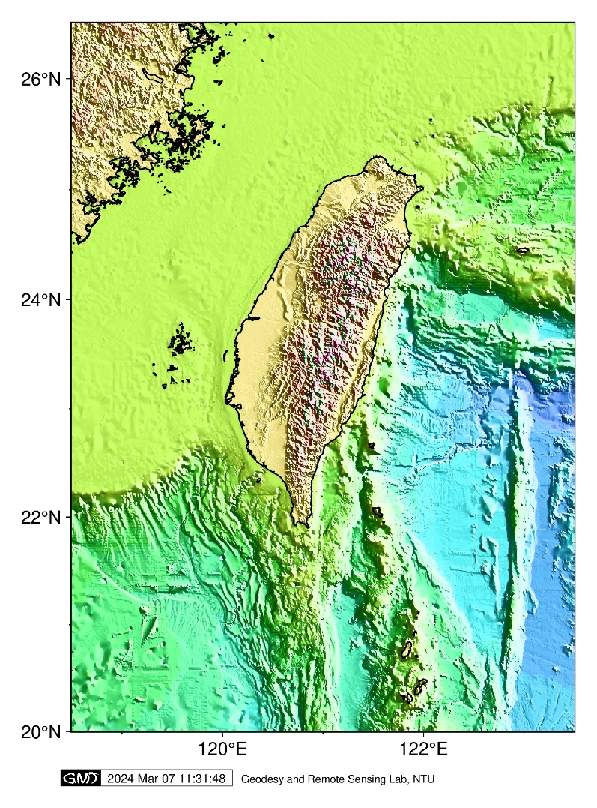
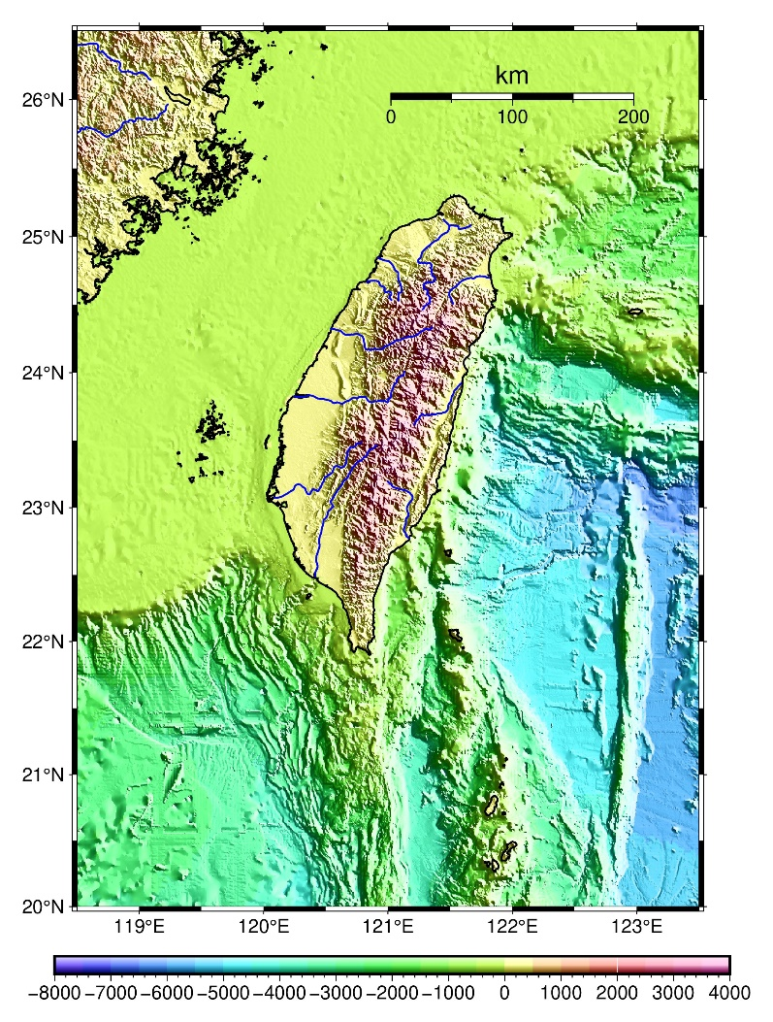
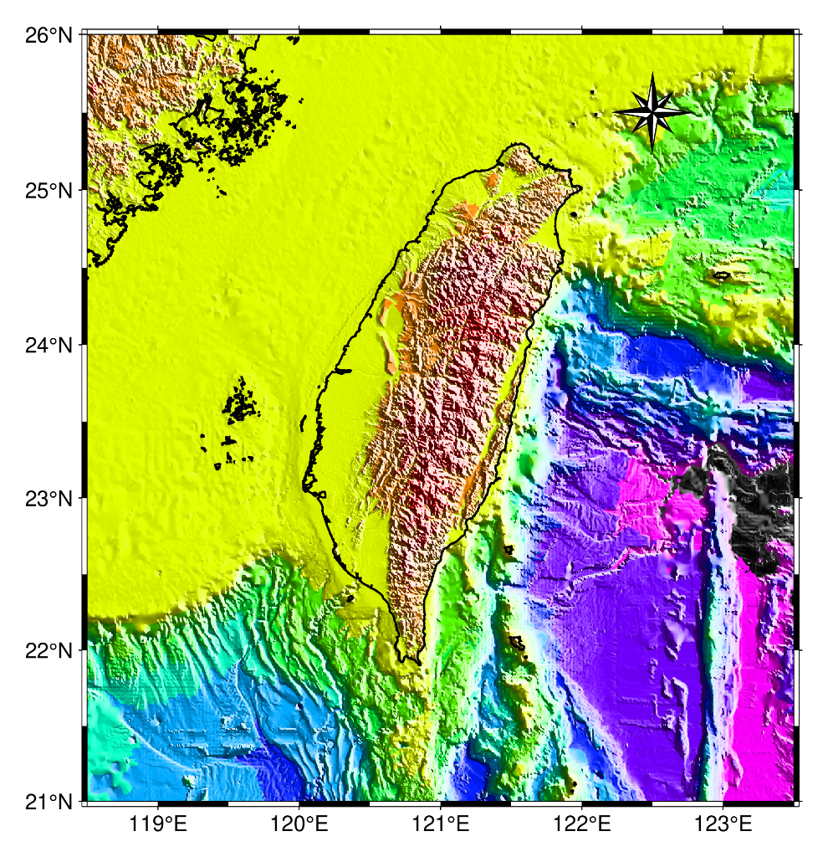


GMT Lect02: Bathymetry & Topography (I)
胡植慶 國立臺灣大學地質科學系
Jyr-Ching HU, Dept. of Geosciences, NTU

Slide 2
GMT commands
gmtset - Change individual GMT default parameters (改變GMT預設参數)
grdcut - Extract subregion from a grid (從一網格檔中裁剪出一子區域的網格檔)
begin - Initiate a new GMT modern mode session (初始化一個新的GMT現代模式腳本)
grdinfo - Extract information from grids (讀取網格檔案資訊)
basemap - Plot PostScript base maps (繪製地圖底圖)
grdgradient - Compute directional derivative or gradient from a grid (從網格檔計算方向導數或梯度)
grdimage - Project grids or images and plot them on maps (投影網格或影像並繪製至地圖上)
coast - Plot continents, shorelines, rivers, and borders on maps (繪製大陸、海岸線、河流和國界線)
colorbar - Plot a gray or color scale-bar on maps (繪製灰階或彩色之色彩條)
psconvert - Convert [E]PS file(s) to other formats using GhostScript (利用ghostscirpt將ps檔轉換成其它圖檔格式)

Slide 3
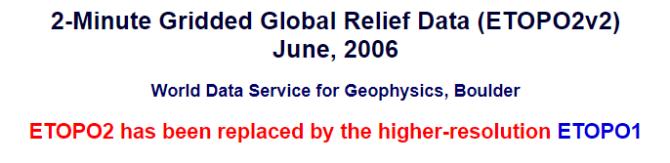
Datasets
DOS/shell commands
set - Allows you to change one variable or string (字符串) to another.
echo - Used to repeat the text typed in back to the screen and can be used to echo to a peripheral on the computer
del/rm - Delete files from the computer
pause - Used within a computer batch file and allows the computer to pause the currently running batch file until the user presses any key
tw_topo500m.nc: 500m resolution of elevation around Taiwan
tbase180.nc or tbase360.nc: terrain-based 5 minutes grid files
@earth_relief_30s: 30 arc second global relief (SRTM30+) (GMT會自動從伺服器上下載該資料檔案，並保存到GMT的快取預設目錄)
etopo2.nc: 2-Minute Gridded Global Relief Data (https://www.ngdc.noaa.gov/mgg/global/etopo2.html)

Slide 4
Shorthand at the Command Prompt
Make a working directory, e.g., at d:/gmtwork
Make a directory to put all the grid files & set a variable for the path of gridfiles, e.g., create d:\gridfiles or c:\gridfiles
Cut ~\Lecture 02\tw_topo500m.nc & put it in d:\gridfiles
建立工作和網格資料目錄或資料夾
工作目錄: d:/gmtwork
網格資料目錄: d:/gridfiles
將下載格資料*.nc (副檔名或後綴名為nc)放入d:/gridfiles
速記符號(shorthand)簡介
~ (tilde, 波浪號): On Unix-like operating systems (Linux & Mac OS), tilde indicates the current user's home directory
Change directory to a path specified working directory: ~ is a short-cut for the absolute path of current GMT home directory, e.g., d:/gmtwork
Shorthand at the bash shell
/ (slash, 斜線、斜槓) – root directory (根目錄)
./ – current directory
../ – parent directory
~ – home directory

Slide 5

Lect02A1_tw_topo500m.bat
set prefix=Lect02A
set grd=c:\gridfiles\tw_topo500m.nc
set int=tw_topo500m.nc.int
REM:註記(remark) ，程式執行時會略過這行，在Linux和MacOS環境下則使用# (hashtag/number sign)表示註記。
set 變數名=字串(set prefix=Lect02A): 設定變數(或變量)供其他指令來使用，而呼叫的方式是%變數名%，範例中將變數名prefix設定成要輸出的pdf檔檔名，之後改輸出檔名時，不必一個個更改。
Lect02A1_tw_topo500m.bat.sh
prefix=Lect02A
grd=c:\gridfiles\tw_topo500m.nc
int=tw_topo500m.nc.int
set - Allows you to change one variable or string (字符串) to another.
%VAR1% (Sequence %%, two percent signs) represents the value of an environment variable named VAR1, sets a new value for PATH.
Shell脚本：直接用prefix=Lect02A ，變數呼叫則是用${prefix} 。
建議把常需更改的值(如輸入網格檔名)，設為變數，並在批次檔或Shell脚本的開頭，設定這些變數。

Slide 6
Lect02A1.bat
Lect02A1.sh
set prefix=Lect02A
set grd=c:\gridfiles\tw_topo500m.nc
set int=tw_topo500m.nc.int
……
echo gridinfo, extract information from netCDF grid file
gmt grdinfo %grd% > tw_topo500m.nc.info
gmt begin %prefix% ps,jpg A+m0.5c
gmt basemap -Jm121/23/1i -R118.5/123.5/20/26.5 -Ba2f1 -U/-0.5/-1.7/"Geodesy and Remote Sensing Lab, NTU" -V
gmt grdgradient %grd% -A10/100 -G%int% -Ne1 -fg -V
gmt grdimage %grd% -Ctopo_sealand.cpt -I%int%
gmt coast -B -Df -W0.8p,0/0/0 -V
gmt end
del %int%
prefix=Lect02A
grd=/c/gridfiles/tw_topo500m.nc
int=tw_topo500m.nc.int
……
echo gridinfo, extract information from netCDF grid file
gmt grdinfo ${grd} > tw_topo500m.nc.info
gmt begin ${prefix} ps,jpg A+m0.5c
gmt basemap -Jm121/23/1i -R118.5/123.5/20/26.5 -Ba2f1 -U/-0.5/-1.7/"Geodesy and Remote Sensing Lab, NTU" -V
gmt grdgradient ${grd} -A10/100 -G ${int} -Ne1 -fg -V
gmt grdimage ${grd} -Ctopo_sealand.cpt -I ${int}
gmt coast -B -Df -W0.8p,0/0/0 -V
gmt end
rm ${int}

Slide 7
echo, echo off
echo gridinfo, extract information from netCDF grid files
gmt grdinfo %grd% > tw_topo500m.nc.info
Batch file
Shell script
echo “gridinfo, extract information from netCDF grid files”
gmt grdinfo ${grd} > tw_topo500m.nc.info
The echo command controls what gets shown on the screen when you run a batch or shell file (echo是一個DOS、Microsoft Windows、Unix和類Unix系統中的指令，用來將字串列出於電腦現顯示器上)
Using the echo command to stop the display, or to make something display, as you wish. (它通常在shell指令碼和批次處理作業中使用，以將狀態訊息顯示至螢幕或檔案中)。
Using “echo” the strings to create a cpt file by “> (greater-than sign, overwrite)” and “>> (sequence greater-than sign, append)” : 利用echo指令可以製作色階檔(*.cpt)，如下例，詳見Lect02B
echo -8000 255 15 255 -7000 255 15 255 > my1st.cpt
echo -7000 255 15 255 -6000 255 75 255 >> my1st.cpt

Slide 8
Grdinfo (讀取網格檔案資訊)
grdinfo - Extract information from grids
gmt grdinfo grdfiles [ -C[n|t] ] [ -D[xoff[/yoff][+n] ] [ -F ] [ -I[dx[/dy] ]|b|i|r] ] [ -L[0|1|2|p|a] ] [ -M ] [ -Rregion ] [ -T[dz][+a[alpha]] [+s] ] [ -V[level] ] [ -fflags ] [ -hheaders ] [ -oflags ] [ --PAR=value ]
Synopsis
語法
gmt grdinfo %grd% > tw_topo500m.nc.info
gmt grdinfo %grd% > tw_relief_15s.nc.info
grdinfo reads a 2-D binary grid file (2進位的格式網格) and reports metadata (元資料:描述資料屬性) and various statistics for the (x,y,z) data in the grid file(s).
Output information contains the minimum/maximum values for x, y, and z, where the min/max of z occur, the x- and y-increments, and the number of x and y nodes.
Optionally: the mean, standard deviation, and/or the median, L1 scale of z, and number of nodes set to NaN (Not a Number，非數).
Report if the grid is pixel- or gridline-registered and if it is a Cartesian or Geographic data set (based on metadata in the file).

Slide 9
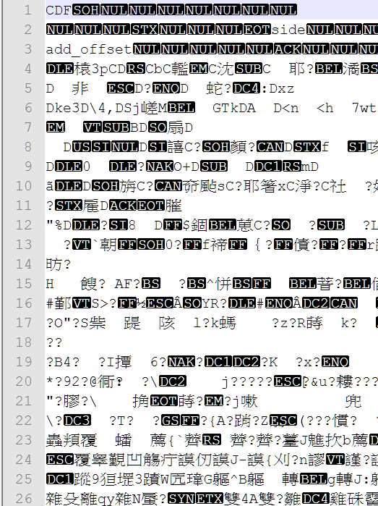
Open tw_topo500m.nc.info by text editor
Open tw_topo500m.nc by text editor
c:\gridfiles\tw_topo500m.nc: Title: surface
c:\gridfiles\tw_topo500m.nc: Command: surface raw.xyz -Gtaidp.v624.grdint_500m.grd -T0.25 -I0.2747m -R117/125/18/27 –V
c:\gridfiles\tw_topo500m.nc: Gridline node registration used [Cartesian grid]
c:\gridfiles\tw_topo500m.nc: Grid file format: cf = GMT netCDF format (32-bit float, deprecated)
c:\gridfiles\tw_topo500m.nc: x_min: 117 x_max: 125 x_inc: 0.00457927876359 name: user_x_unit nx: 1748
c:\gridfiles\tw_topo500m.nc: y_min: 18 y_max: 27 y_inc: 0.00457782299084 name: user_y_unit ny: 1967
c:\gridfiles\tw_topo500m.nc: v_min: -7238.87060547 v_max: 3684.15844727 name: user_z_unit
c:\gridfiles\tw_topo500m.nc: scale_factor: 1 add_offset: 0
c:\gridfiles\tw_topo500m.nc: format: classic
c:\gridfiles\tw_topo500m.nc: Default CPT:

Slide 10
Using text editor to open tw_relief_15s.nc.info
tw_relief_15s.nc: Title
tw_relief_15s.nc: Command: gmt grdcut @earth_relief_15s_p/ -R118.5/123.5/20/26.5 -Gtw_relief_15s.nc
tw_relief_15s.nc: Remark:
tw_relief_15s.nc: Pixel node registration used [Geographic grid]
tw_relief_15s.nc: Grid file format: nf = GMT netCDF format (32-bit float), CF1.7
tw_relief_15s.nc: x_min: 118.5 x_max: 123.5 x_inc: 0.00416666666667 (15 sec) name: longitude n_columns: 1200
tw_relief_15s.nc: y_min: 20 y_max: 26.5 y_inc: 0.00416666666667 (15 sec) name: latitude n_rows: 1560
tw_relief_15s.nc: v_min: -6778 v_max: 3757 name: z
tw_relief_15s.nc: scale_factor: 1 add_offset: 0
tw_relief_15s.nc: format: netCDF-4 chunk_size: 134,130 shuffle: on deflation_level: 3
tw_relief_15s.nc: Default CPT: geo

Slide 11
GMT netCDF grid format
Nota bene:
tw_topo500m.nc: Grid file format: cf = GMT netCDF format (32-bit float, deprecated)
tw_relief_15s.nc: Grid file format: nf = GMT netCDF format (32-bit float), CF1.7
ID | Explanation
nb | GMT netCDF format (8-bit integer, COARDS, CF-1.5)
ns | GMT netCDF format (16-bit integer, COARDS, CF-1.5)
ni | GMT netCDF format (32-bit integer, COARDS, CF-1.5)
nf | GMT netCDF format (32-bit float, COARDS, CF-1.5)
nd | GMT netCDF format (64-bit float, COARDS, CF-1.5)
cb | GMT netCDF format (8-bit integer, deprecated)
cs | GMT netCDF format (16-bit integer, deprecated)
ci | GMT netCDF format (32-bit integer, deprecated)
cf | GMT netCDF format (32-bit float, deprecated)
cd | GMT netCDF format (64-bit float, deprecated)
bm | GMT native, C-binary format (bit-mask)
bb | GMT native, C-binary format (8-bit integer)
bs | GMT native, C-binary format (16-bit integer)
bi | GMT native, C-binary format (32-bit integer)
bf | GMT native, C-binary format (32-bit float)
bd | GMT native, C-binary format (64-bit float)
netCDF: Network Common Data Form
COARDS: Cooperative Ocean/Atmosphere Research Data Service
CF-1.5: NetCDF Climate & Forecast (CF) Metadata Conventions

Slide 12
grdcut (從一網格檔中裁剪出一子區域的網格檔)
Extract subregion from a grid
gmt grdcut ingrid -Goutgrid -Rregion [ -Jparameters ] [ -N[nodata] ] [ -Slon/lat/radius[unit][+n] ] [ -V[level] ] [ -Z[min/max][+n|N |r] ] [ -fflags ] [ --PAR=value ]
ingrid: input grid file (輸入網格檔名，*.nc)
Outgrid: output grid file (輸出網格檔名, *.nc)
-R: Specify the region of interest. This defines the subregion to be cut out (直接指定關注區域的範圍並切出子區域)
-N: Allow grid to be extended if new -R exceeds existing boundaries. Append nodata value to initialize nodes outside current region [Default is NaN]. (允許新網格的區域範圍超過原網格的區域範圍。超出的區域範圍內，網格節點會被賦以指定的值，預設值為NaN，也可自行設定nodata的值域)
-S: Specify an origin and radius; append a distance unit and we determine the corresponding rectangular region so that all grid nodes on or inside the circle are contained in the subset. (指定圓心位置及其半徑，程式自動算出一矩形區域，該矩形區域包含圓上及圓內所有網格點)

Slide 13
gmt begin: Initiate a new GMT modern mode session (初始化一個新的GMT現代模式腳本)
gmt begin %prefix% ps,jpg A+m0.5c
gmt begin [prefix] [formats] [options] [ -V[level] ]
Prefix: Name-stem used to construct the single final figure name. The extension is appended automatically from your formats selection(s) [gmtsession]. (檔案名稱的首碼或前綴，副檔名或尾碼則由formats選定，預設值由gmtsession設定)
Formats: Give one or more comma-separated graphics extensions from the list of allowable graphics formats (default is configurable via setting GMT_GRAPHICS_FORMAT [pdf]). (繪圖檔案格式，若輸出多個格式，可用逗號分開。預設繪圖格式為pdf，由參數GMT_GRAPHICS_FORMAT控制)
Options: Sets one or more comma-separated options (and possibly arguments) that can be passed to psconvert when preparing a session figure [A]. (GMT現代模式先生成PS 檔，再預設由psconvert指令自動轉換成使用者指定的繪圖格式。選項參數参見psconvert的選項設定。預設值為A，表示將-A 選項傳給psconvert)
Valid subset of options: A[args],Cargs,Ddir,Edpi,Hfactor,Margs,Qargs,S. See the psconvert documentation for details on these options
Nota bene:在begin模組指令中使用pscomvert的參數，不用加”-”

Slide 14
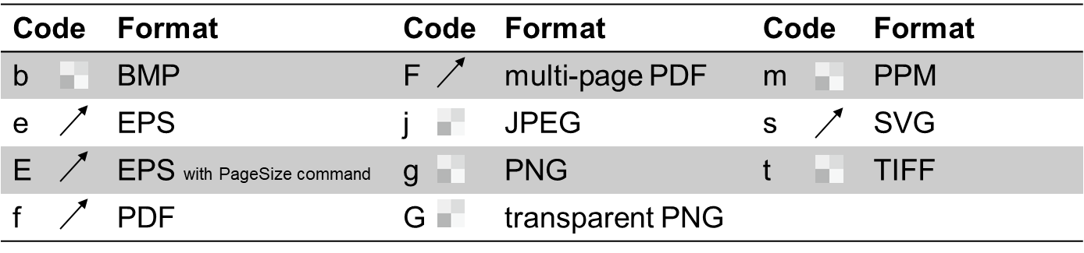

psconvert (將ps檔轉換成其它圖檔格式)
echo Convert PS files to raster
REM gmt psconvert %prefix% -Tt –A0.5i –E400
-Tb|e|E|f|F|j|g|G|m|s|t [+m] (圖檔格式，向量或矢量格式和影像格式): Append +m in order to get a monochrome (grayscale) image.
-A[+gpaint][+mmargins][+n][+p[pen]][+r][+s[m]|Swidth[u]/height[u]][+u]: Adjust the BoundingBox (定界框,整數) & HiResBoundingBox (定界框,小數) to the minimum required by the image content (調整定界框邊界至最貼齊圖形).
-Eresolution: Set raster (點陣圖) resolution in dpi [default = 720 for PDF, 300 for others]. Limited pixel dimension: a raster to be less than or equal to 65536.
-Gghost_path: Full path to your Ghostscript executable. (GMT安裝時若勾選GHOSTSCRIPT，則psconvert會使用C:\programs\gmt6\bin\gswin64c.exe程式將ps檔轉成其它圖檔格式。另外用gs950w64.exe安裝ghostscript ，其預設路徑為C:\Program Files\gs\gs9.50\bin

Slide 15
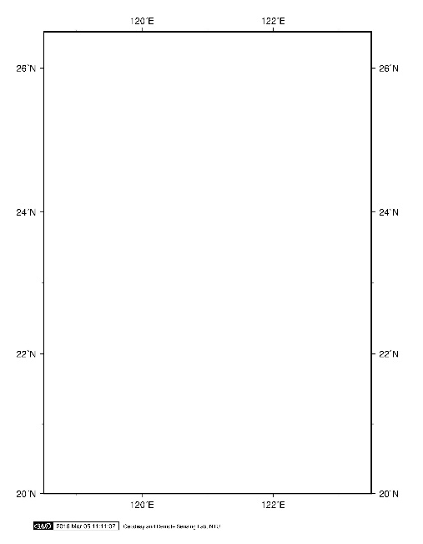
gmt basemap (繪製底圖)
Plot PostScript base maps
gmt basemap -Jparameters -Rwest/east/south/north[/zmin/zmax][+r][+uunit] [ -A[file] ] [ -B[p|s]parameters ] [ -Fbox ] [ -Jz|Zparameters ] [ -Lscalebar ] [ -U[stamp] ] [ -Trose ] [ -Tmag_rose ] [ -V[level] ] [ -X[a|c|f|r][xshift[u]] ] [ -Y[a|c|f|r][yshift[u]] ] [ -fflags ] [ -pflags ] [ -ttransp ] [ --PAR=value ]
gmt basemap -Jm121/23/1.2i -R118.5/123.5/20/26.5 -Ba2f1 -U/-0.5/-1.7/"Geodesy and Remote Sensing Lab, NTU" -V
Nota bene: No space between the option flag (選項旗標) & the associated arguments (命令後面所輸入的字串參數) (選頂和参數之間不能有空格)
gmt pasemap的繪製圖框功能可以用其模組指令gmt coast ，定義-J和-B相同的選頂及參數取代

Slide 16
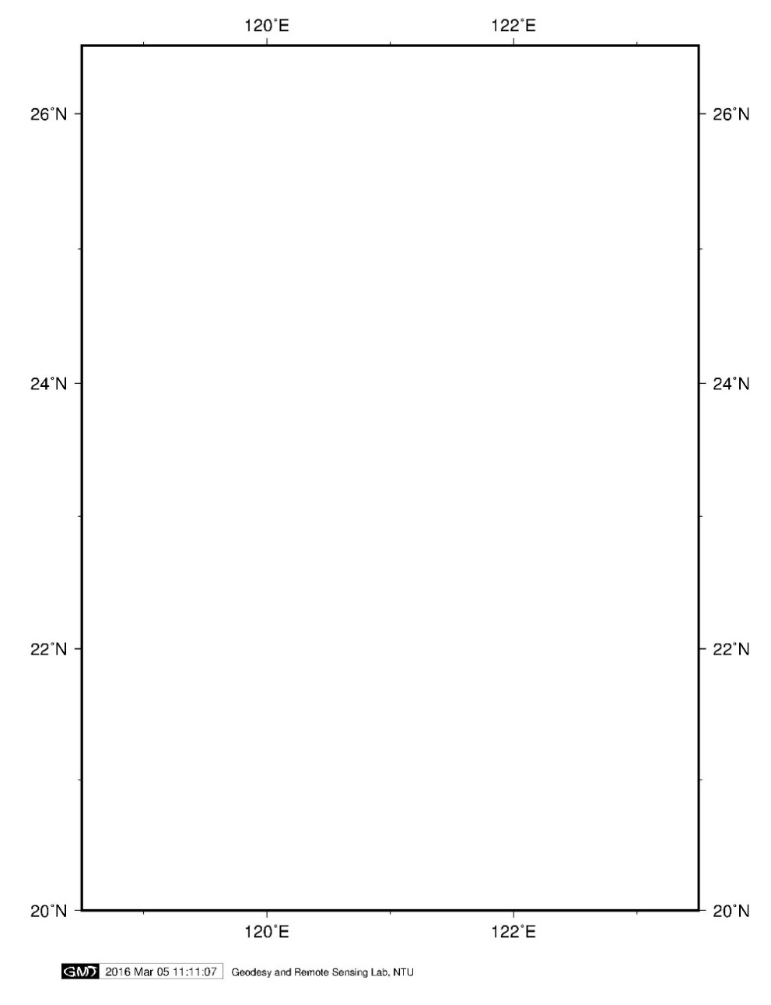
Lect02A
gmt basemap -Jm121/23/1.2i -R118.5/123.5/20/26.5 -Ba2f1 -U/-0.1i/-0.5i/"Geodesy and Remote Sensing Lab, NTU"
-Jm1.2i: A Mercator map with scale 1.2 inch/degree along equator
-Ba2f1: Set map boundary intervals. a is used to specify the annotation and major tick spacing , f for minor tick spacing (設定地圖框標注和)
U/-0.5/-1.7/"Geodesy and Remote Sensing Lab, NTU" : Draw GMT time stamp logo on plot. Using quotation marks (雙引號, “ “) to quote the string

Slide 17
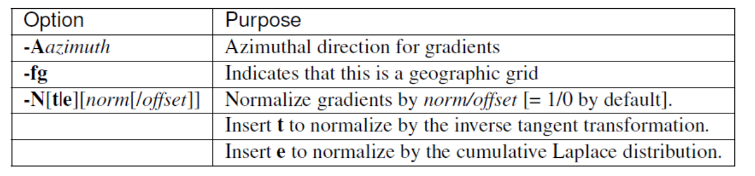
Grdgradient (從網格檔計算方向導數或梯度)
gmt grdgradient in_grdfile -Gout_grdfile [ -Aazim[/azim2] ] [ -D[a][c][o][n] ] [ -E[m|s|p]azim/elev[+aambient][+ddiffuse][+pspecular][+sshine] ] [ -N[e|t][amp][+ssigma][+ooffset] ] [ -Qc|r|R [ -Rregion ] [ -Sslopefile ] [ -V[level] ] [ -fflags ] [ -nflags ] [ --PAR=value ]
-G輸出檔名: 輸出的檔案名稱
-A方位角：光源照射的方位角
-N:正規化光照梯度(振幅)
-fg：地理坐標網格
To make a file for illuminating the data in geoid.nc using exp-normalized gradients in the range [-0.6,0.6] imitating light sources in the north and west directions:
gmt grdgradient geoid.nc -A0/270 -Ggradients.nc=nb/a -Ne0.6 -V
nb: GMT netCDF format (8-bit integer, COARDS, CF-1.5)

Slide 18
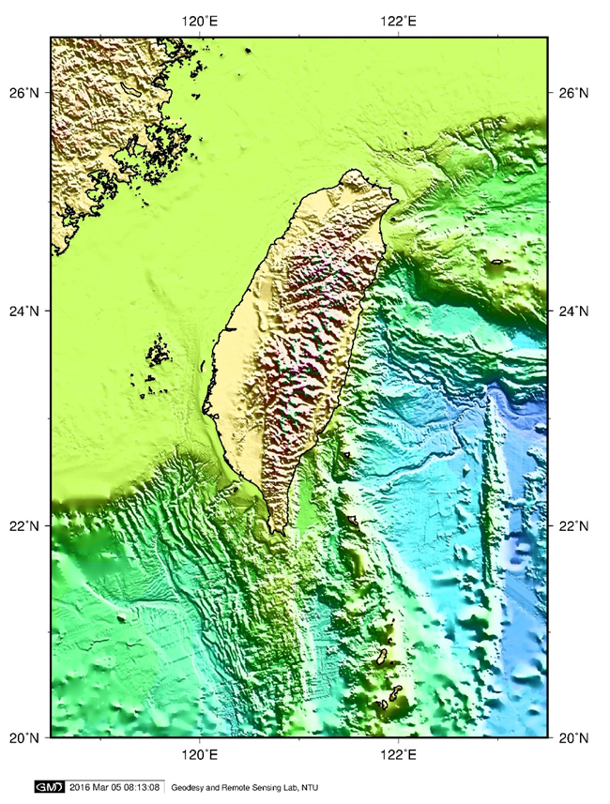
Lecto2A
gmt grdgradient %grd% -A10/110 -G %int% -Ne1 –fg
Input grid file: tw_topo500m.nc, 2-D grid file from which to compute directional derivative
-A10/100 : Azimuthal direction for a directional derivative (方向導數). -Aazim/azim2, is useful for illuminating data with two directions of lineated structures.
-G%int% : Name of the output grid file for the directional derivative
-N: Normalization. [Default: no normalization.]
-fg: Geographic grids (dimensions of longitude, latitude) will be converted to meters via a “Flat Earth” approximation using the current ellipsoid parameters.

Slide 19
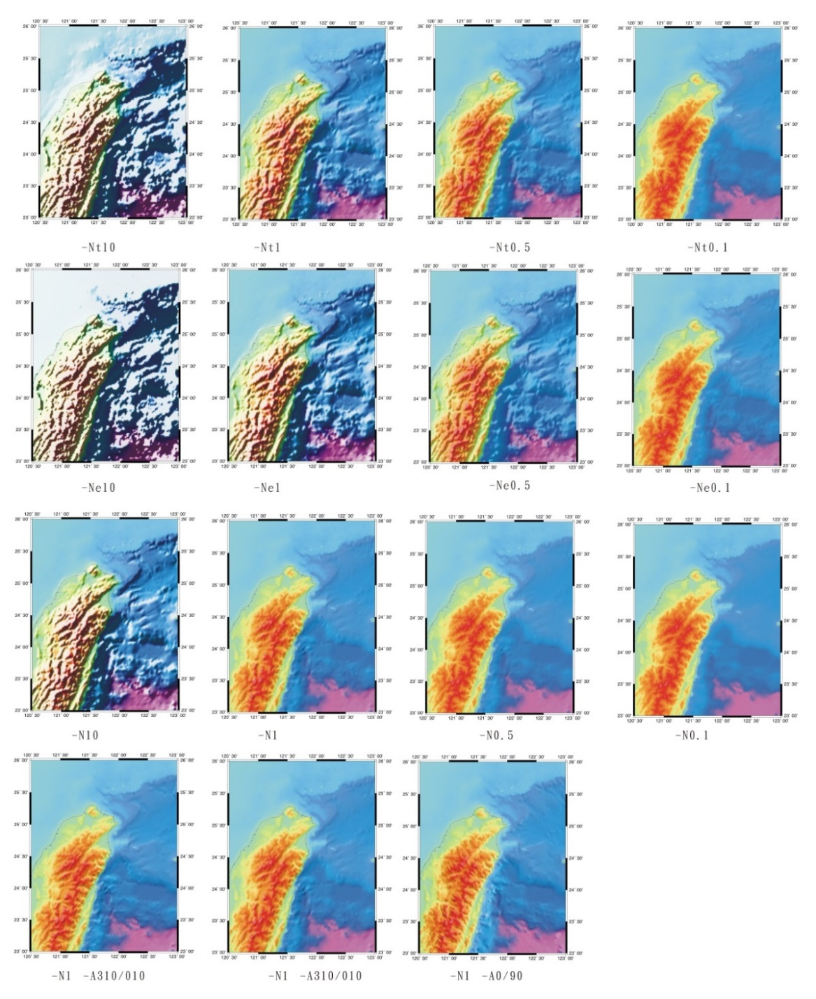
Normalization –N (正規化光照梯度)
-N[e][t][amp][/sigma[/offset]]
Actual gradients g: offset & scaled to produce normalized gradients gn with a maximum output magnitude of amp.
If amp is not given, default amp = 1. If offset is not given, it is set to the average of g.
−N yields gn = amp * (g - offset)/max(abs(g-offset)).
光照效果：計算每個點沿著某個方位角的方向梯度，然後根據每個點的方向梯度的正負以及振幅調節該點顏色的亮度值。
向光處，方向梯度為正值，增加該點顏色的亮度；對於背陰處，方向梯度為負值，則降低該點顏色的亮度。可增強地貌的立體感。

Slide 20

Normalization –N (正規化光照梯度)
-N[e][t][amp][/sigma[/offset]]
-Ne normalizes using a cumulative Laplace distribution yielding gn = amp * (1.0 - exp(sqrt(2) * (g - offset)/ sigma)) where sigma is estimated using the L1 norm of (g - offset) if it is not given.
-Nt normalizes using a cumulative Cauchy distribution yielding gn = (2 * amp / PI) * atan( (g - offset)/ sigma) where sigma is estimated using the L2 norm of (g - offset) if it is not given

Slide 21
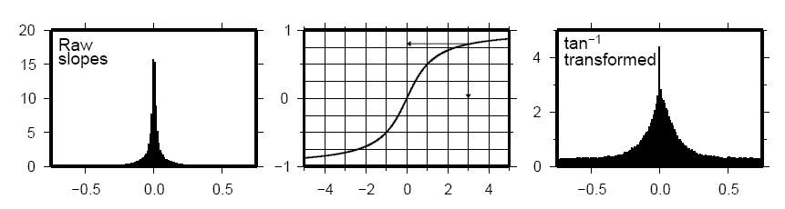
How the inverse tangent operation works?
–N[t|e][norm[/offset]]
Normalize gradients by norm/offset [= 1/0 by default].
Insert t to normalize by the tan⁻¹ transformation
Insert e to normalize by the cumulative Laplace distribution
Both –Ne and –Nt yield well behaved gradients.
Personally, we prefer to use the –Ne option; the value of norm is subjective and you may experiment somewhat in the 0.5–5 range.

Slide 22
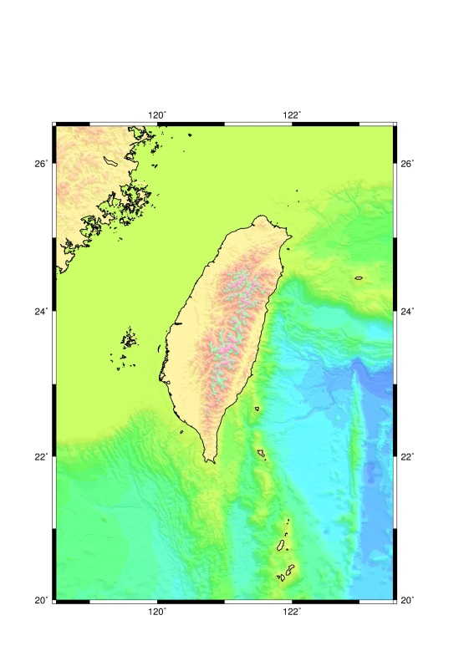
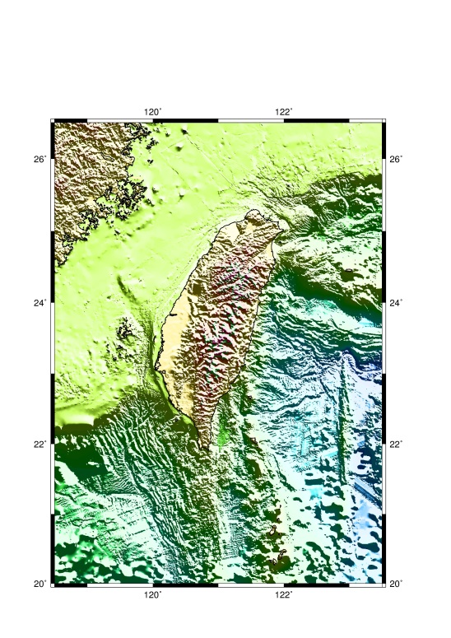
Lect02A
gmt grdgradient %grd% –A10/110 -Gtw_topo4.nc.int -Ne1 –fg
If you don’t know what -N options to use to make an intensity file for grdimage or grdview, a good first try is -Ne0.6.
Please try:
-Ne0.6, –Ne0.1 and –Ne10

Slide 23
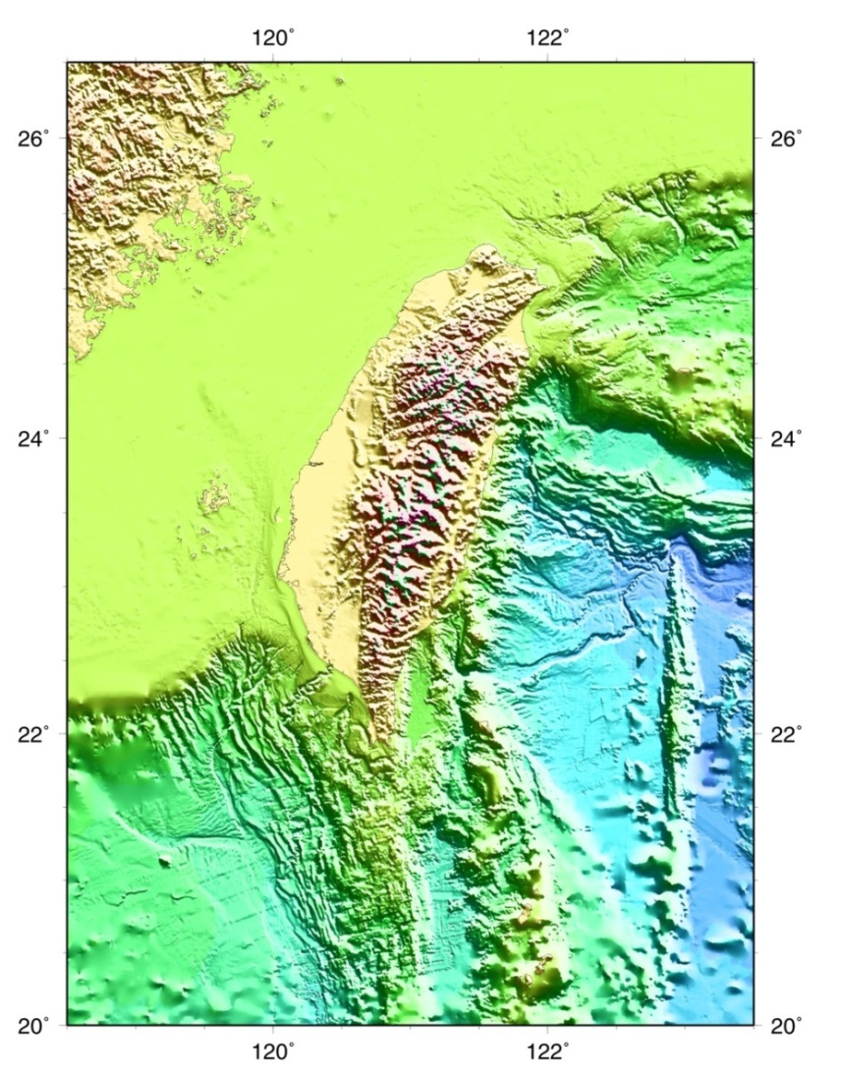
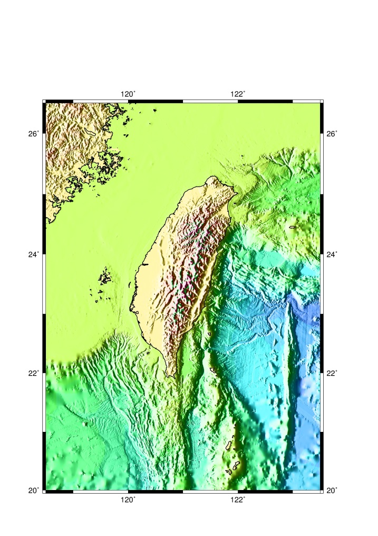
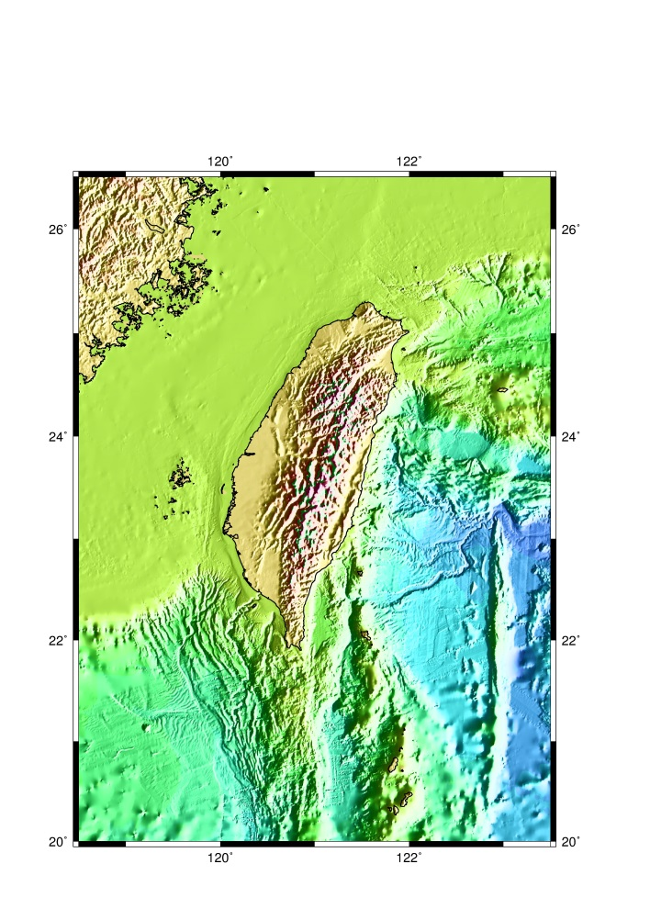
Lect02A
gmt grdgradient %grd% –A10/110 -G%int% -Ne1 –fg
Please try:
-A270, –A110 and -A115/205
Detailed, please see:
Horn, B.K.P., Hill-Shading and the Reflectance Map, Proceedings of the IEEE, 69(1), 1981,14-47.

Slide 24

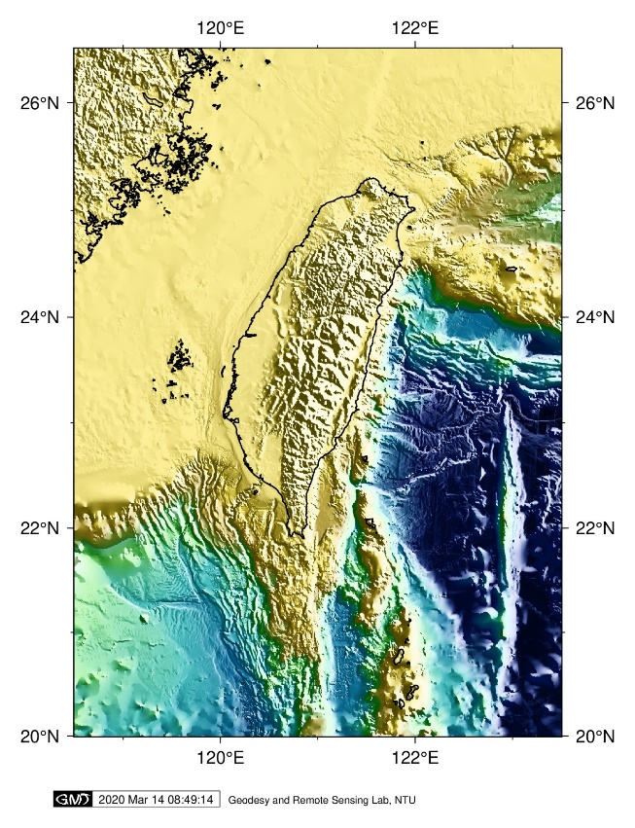
grdimage (投影網格或影像並繪製至地圖上)
Project and plot grids or images
gmt grdimage grd_z | img | grd_r grd_g grd_b [ -Aout_img[=driver] ] [ -B[p|s]parameters ] [ -Ccpt ] [ -D[r] ] [ -E[i|dpi] ] -Jparameters [ -Gcolor[+b|+f] ] [ -I[intensfile|intensity|modifiers] ] [ -M ] [ -N ] [ -Q ] [ -Rwest/east/south/north[/zmin/zmax][+r][+uunit] ] [ -U[stamp] ] [ -V[level] ] [ -X[a|c|f|r][xshift[u]] ] [ -Y[a|c|f|r][yshift[u]] ] [ -fflags ] [ -nflags ] [ -pflags ] [ -tr ] [ --PAR=value ]
gmt grdimage %grd% -Ctopo_sealand.cpt -I%int% -V
Change cpt file using topo_relief.cpt
%grd%: Input grid file, tw_topo500m.nc
-Ctopo_sealand.cpt : cptfile
-I%int%: intensity file made from gmt grdgradient
-V: Select verbose operation

Slide 25
grdimage (投影網格或影像並繪製至地圖上)
gmt grdimage grd_z | img | grd_r grd_g grd_b [ -Aout_img[=driver] ] [ -B[p|s]parameters ] [ -Ccpt ] [ -D[r] ] [ -E[i|dpi] ] -Jparameters [ -Gcolor[+b|+f] ] [ -I[intensfile|intensity|modifiers] ] [ -M ] [ -N ] [ -Q ] [ -Rwest/east/south/north[/zmin/zmax][+r][+uunit] ] [ -U[stamp] ] [ -V[level] ] [ -X[a|c|f|r][xshift[u]] ] [ -Y[a|c|f|r][yshift[u]] ] [ -fflags ] [ -nflags ] [ -pflags ] [ -tr ] [ --PAR=value ]
grd_z (輸入網格資料): grdimage reads one 2-D grid file & produces a gray-shaded (or colored) map by plotting rectangles centered on each grid node and assigning them a gray-shade (or color) based on the z-value
-Ccpt: 給定色階檔
-I[intensfile|intensity] (給定由grdgradient指令製作之光照强度檔): Illumination may be added by providing a file with intensities in the (-1,+1) range
If no argument is given: Derive an intensity grid from the input data grid grd_z via a call to grdgradient using the arguments -A-45 and -Nt1 for that module.
Default is no illumination (預設值無光照效果)

Slide 26
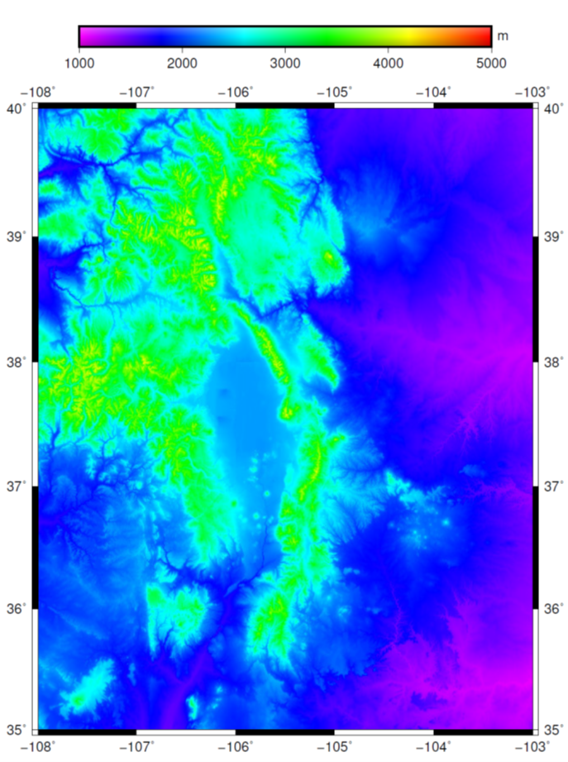
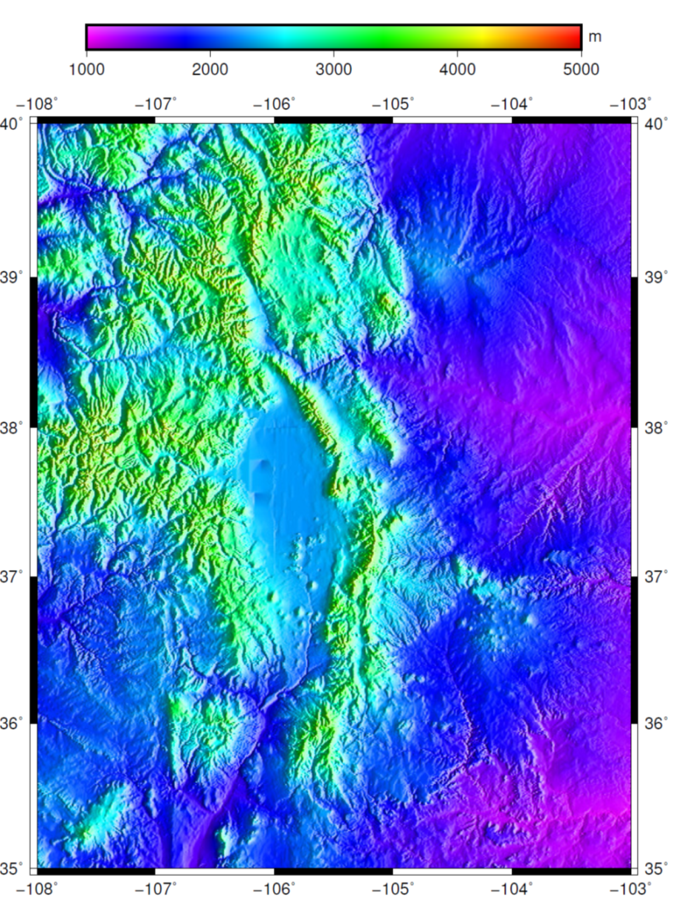
Open and run tut_15.bat or tut_15.sh
gmt set GMT_DATA_SERVER_LIMIT 0
REM gmt grdcut @earth_relief_30s -R-108/-103/35/40 -Gtut_relief.nc
gmt begin GMT_tut_15
gmt makecpt -Crainbow -T1000/5000
gmt grdimage @tut_relief.nc -JM6i -B -BWSnE
gmt colorbar -DJTC -I0.4 -Bxa -By+lm
gmt end
@earth_relief_30s: 30 arc second global relief (SRTM30+) (GMT會自動從伺服器上下載該資料檔案，並保存到GMT的快取預設目錄)
Open and run tut_16.bat or tut_16.sh
gmt begin GMT_tut_16
gmt makecpt -Crainbow -T1000/5000
gmt grdgradient tut_relief.nc -Ne0.8 -A100 -fg -Gus_i.nc
gmt grdimage tut_relief.nc -Ius_i.nc -JM6i -B -BWSnE
gmt colorbar -DJTC -I0.4 -Bxa -By+lm
gmt end

Slide 27
Color Palette Tables: cpt-file (色階檔)
Color palette Tables (cpt-file): Colored images or shaded reliefs, need to be told what colors to use and over what z-range each color applies.
CPTs can be created in any number of ways. GMT provides two mechanisms (製作色階檔，將在Lecture 03介紹)
1. makecpt: Create simple, linear color tables given a built-in master color table and the desired z-values at color boundaries
2. grd2cpt: Create color tables based on a master CPT color table and the histogram-equalized distribution of z-values in a gridded data file
Color model: RGB (Red, Green, Blue) system or in the HSV system (Hue, Saturation, Value,色相、飽和度、明度).
The parameter COLOR_MODEL (COLOR_MODEL = none) in the gmt.conf file must be set accordingly.
Cpt-file for RGB system:
z0 Rmin Gmin Bmin z1 Rmax Gmax Bmax
…..
zn-2 Rmin Gmin Bmin zn-1 Rmax Gmax Bmax

Slide 28
Color Palette Tables cont.
Background color (for z-values < Z0), Foreground color (for z-values > Zn-1 ), and not-a-number (NaN) color (for z-values = NaN) are all defined in the gmt.conf file, but can be overridden by the statements
B Rback Gback Bback
F Rfore Gfore Bfore
N Rnan Gnan Bnan
Color palette tables that contain grayshades only may replace the r-g-b triplets with a single grayshade in the 0–255 range.
色階的概念是將某一區段(slice)的資料用一種顏色來表示
檔案開始用#註解，之後文字通常會紀錄設計者名稱、設計目的、使用的顏色模型(COLOR_MODEL)
檔案的格式分為四欄， 第一欄是起始範圍；第二欄色碼；第三欄是結束範圍；第四欄色碼。
檔案的最下面B、F、N分別代表背景色(Background color)、前景色(Foreground color)及非數的顏色(NaN color)

Slide 29
Cpt-file in RGB (RGB色階檔)
Open topo_relief.cpt
-7238.87060547 black -4713.4834444 0/8/40
-4713.4834444 0/8/40 -3764.26396741 0/94/140
-3764.26396741 0/94/140 -3079.8099417 68.8/187.6/187.2
………..
-132.401333277 251.6/237.2/146.8 816.818143712 252.4/245.4/192.6
816.818143712 252.4/245.4/192.6 3684.15844727 white
B black
F white
N white
slice 30 < z < 80 is painted with pattern # 16 at 200 dpi,
slice 80 < z < 100 is skipped,
slice 100 < z < 200 is painted in a range of dark red to yellow
slice 200 < z < 300 will linearly yield
colors from yellow to green, depending on the actual value of z.
色階檔：色碼可用r/g/b外，也可用顏色名，亦可用暈滃線圖案(pattern)
P200/16:16號圖案，解析度200dpi

Slide 30
Predefined bit & hachure patterns in GMT: -Gp & -GP
GMT provides 90 different bit and hachure (暈滃線) patterns: selected with the -Gp or -GP option in most plotting programs.
Left side of each image was created using -Gp, the right side shows the inverted version using -GP.
Patterns are reproduced below at 300 dpi.

Slide 31

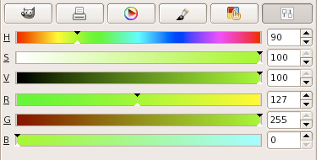
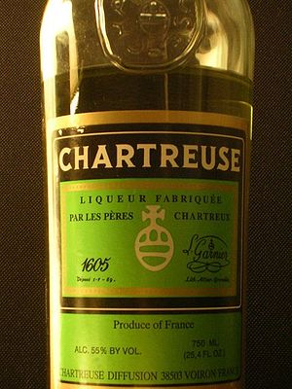
HSV (hue-saturation-value)
HSV color space
HSV (hue, saturation, value): 通過h-s-v格式指定顏色，其中HSV 分別代表色相(Hue)、飽和度(Saturation)和明度Value)，三者之間用破折號-分開，如90-1-1。
cylindrical geometry, with hue, starting at the red primary at 0°, passing through the green primary at 120° and the blue primary at 240°, and then wrapping back to red at 360° (取值範圍為0到360 ，紅原色從0開始過渡到120為綠原色，過渡到240為藍原色再回到360為紅色)
Saturation (from 0 to 1, or 100%) tells you how ‘full’ your color is: reduce it to zero and you only have gray scales (飽和度是指色彩的純度，越高色彩越純，低則逐漸變灰，取值範圍為0 到1，若值為0，則為灰階)
Value (from 0 to 1, or 100%) will bring you from black to a fully saturated color (明度是色彩的亮度，取值範圍為0到1，從暗到亮)
Chartreuse (黃綠色) in GIMP.
Chartreuse:夏翠絲或蕁麻酒，在1605年，由法王亨利四世的炮兵元帥 François Hannibal d’Estrées 記錄長生不老藥方

Slide 32
Cpt-file in HSV (HSV色階檔)
Open topo_sealand.cpt
# cpt file created by: grd2cpt -V topo4.grd -Csealand -L-8000/4000 -S-8000/4000/500
#COLOR_MODEL = HSV (Hue, Saturation, value)
#
-8000 249.375 0.6 1 -7500 249.375 0.6 1
-7500 238.125 0.6 1 -7000 238.125 0.6 1
-7000 226.875 0.6 1 -6500 226.875 0.6 1
………..
2500 343.125 0.29375 1 3000 343.125 0.29375 1
3000 331.875 0.25625 1 3500 331.875 0.25625 1
3500 320.625 0.21875 1 4000 320.625 0.21875 1
B 254.902 0.6 1
F 314.118 0.2 1
N 0 0 0.501961

Slide 33
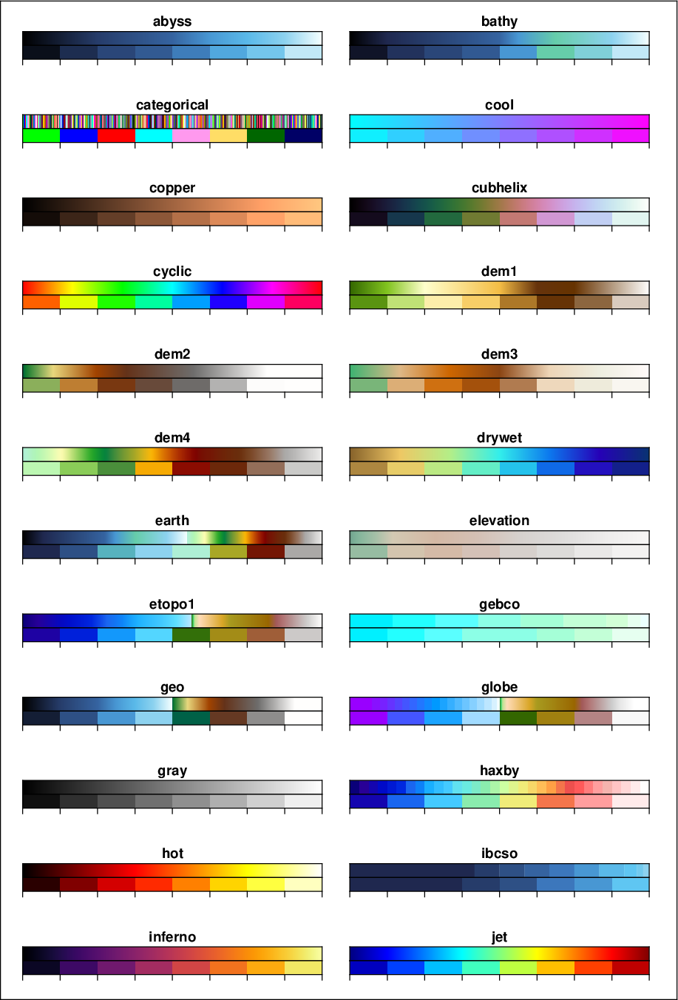
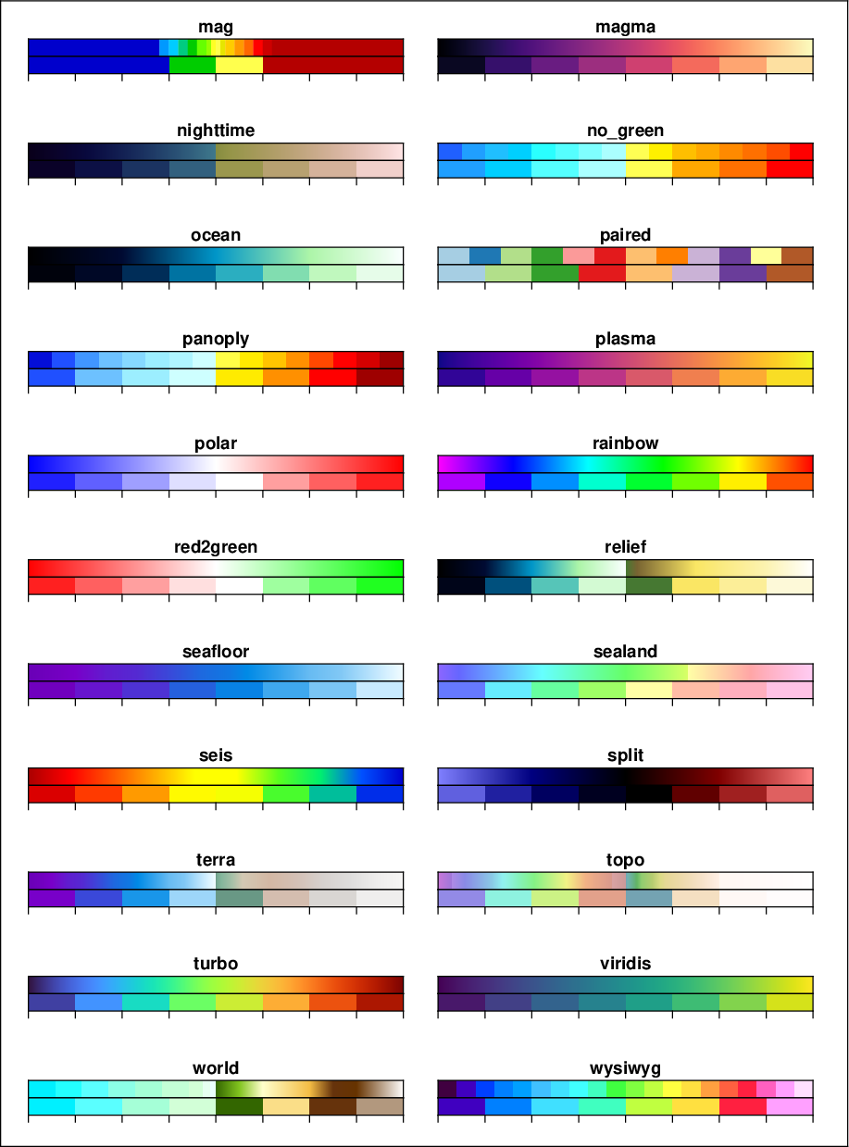
Built-in Color palette tables (cpt)
Built-in color palette tables (cpt): 70 Master cpt files
Path: C:\programs\gmt6\share\cpt

Slide 34
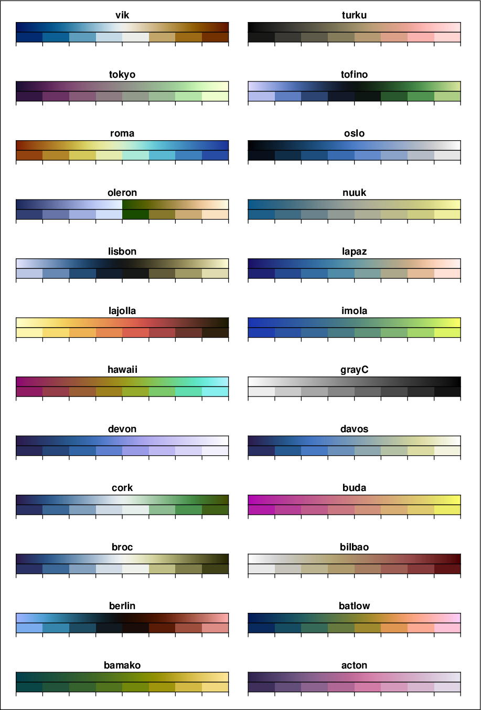
Built-in Color palette tables (cpt)
New Built-in Color palette tables (cpt): Scientific colour map
http://www.fabiocrameri.ch/colourmaps.php
GMT 內置CPT 檔(*.cpt)，常針對特定的需求設計的，因而常用於特定的繪圖目的如下：
1. 海深 (bathymetry)：abyss, bathy, gebco, ibcso
2. 陸上高程：elevation, dem1, dem2, dem3, dem4、
3. 全球地形起伏：earth、etopo1、geo、globe、oleron relief、terra、topo、world
4. 地震成像：seis、polar
5. 分類型資料 (categorical data)：categorical
6. intensities: cubhelix
7. Cyclic spectrum: cyclic

Slide 35
gmt coast (繪製大陸、海岸線、河流和國界線)
Plot continents, shorelines, rivers, and borders on maps
gmt coast -Jparameters -Rregion [ -Amin_area[/min_level/max_level][+a[g|i][s|S]][+r|l][+ppercent] ] [ -B[p|s]parameters ] [ -C[l|r/]fill ] [ -Dresolution[+f] ] [ -Edcw ] [ -Fbox ] [ -Gfill|c ] [ -Iriver[/pen] ] [ -Jz|Zparameters ] [ -Lscalebar ] [ -M ] [ -Nborder[/pen] ] [ -Q ] [ -Sfill|c ] [ -Trose ] [ -U[stamp] ] [ -V[level] ] [ -W[level/]pen ] [ -X[a|c|f|r][xshift[u]] ] [ -Y[a|c|f|r][yshift[u]] ] [ -bobinary ] [ -pflags ] [ -ttransp ] [ --PAR=value ]
gmt coast -Dh -W0.8p,0/0/0 -V
-Amin_area[/min_level/max_level][+a[g|i][s|S]][+r|l][+ppercent]
Features with an area smaller than min_area in km^2 or of hierarchical level that is lower than min_level or higher than max_level will not be plotted [Default is 0/0/4 (all features)]. (不繪製面積小於min_area 平方公里千米或湖泊級別不在[min_level/max_level] 範圍的邊界區域，如湖泊或島嶼。預設值為0/0/4，意即繪製0 到4級所有級別的面積大於0的湖泊)
Level 2 (lakes) contains regular lakes and wide river bodies which we normally include as lakes; append +r to just get river-lakes or +l to just get regular lakes. (對於level=2的湖岸線，包含湖泊及很寬的河流。加上+r 則只繪製河流，加上+l 則只繪製湖泊)

Slide 36

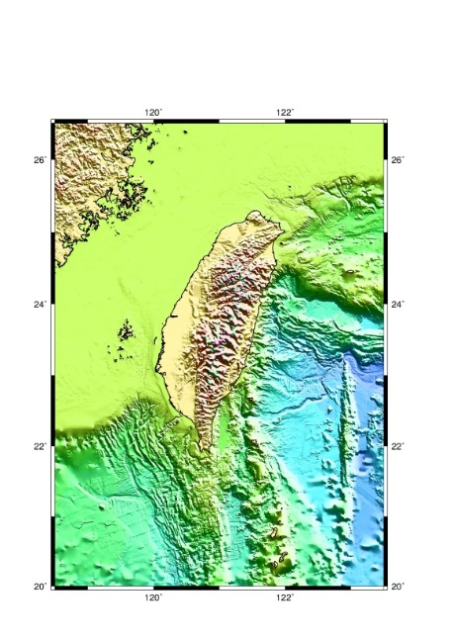
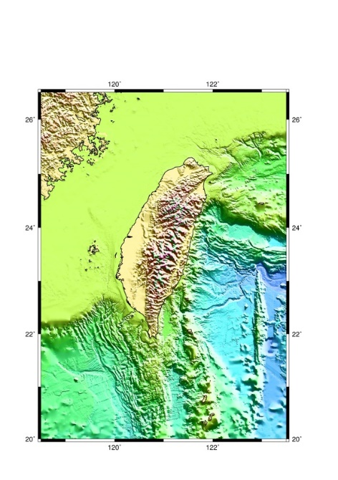
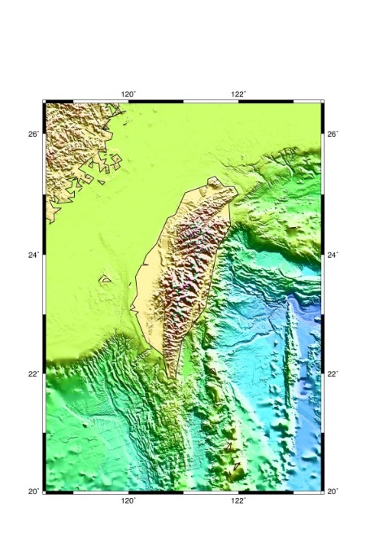
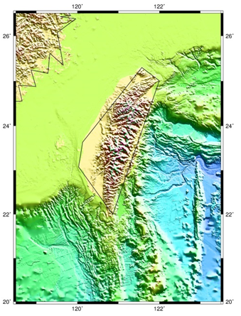
gmt coast -Dh -W0.8p,0/0/0 -V
-Dresolution[+f]: Selects the resolution of the data set to use ((f)ull, (h)igh, (i)ntermediate, (l)ow, and (c)rude). (選擇海岸線資料精度。GMT內建的GSHHG 海岸線資料有5 個不同精度的版本，從高到低依次為：full、high、intermediate、low 和crude)
-Da: Choose (a)uto to automatically select the best resolution given the chosen map scale (依據目前繪圖區域的大小，自動選擇合適的精度，預設使用-Da)
+f: Automatically select a lower resolution should the one requested not be available (則指令找不到指定的精度資料時，自動尋找更低精度的資料)
Try: -Df, –Di, –Dl and –Dc

Slide 37
Draw shorelines
gmt coast -Dh -W0.8p,0/0/0 -V
-W[level/] pen [width[c|i|p]],[color],[style[c|i|p|]]
-W[level/]pen: Draw shorelines [Default is no shorelines]. Append pen attributes [Defaults: width = default, color = black, style = solid] which apply to all four levels (繪製四個等級的岸線。岸線指水體與陸地交界，岸線畫筆由寬度、顏色及樣式設定，参數用逗號隔開)
Prepend level/: where level is 1-4 and represent coastline, lakeshore, island-in-lake shore, and lake-in-island-in-lake shore (岸線分成四個等級，設定1至4，分別為海岸線、湖泊岸線、湖中島岸線及湖中島中湖的岸線)
Repeat -W as needed: When specific level pens are set, those not listed will not be drawn [Default draws all levels; but see -A]. (在同一指令中，可以使用-W，以指定不同等級岸線的畫筆屬性，岸線等級及畫筆屬性用斜線隔開。預設為繪製四個等級的線，但由-A設定最小面積以下的水體或島嶼，則不繪製)

Slide 38
Specifying pen attributes
gmt coast -Dh -W0.8p,0/0/0 -V
-W[level/] pen [width[c|i|p]],[color],[style[c|i|p|]]
The attributes of lines and symbol outlines as defined by pen is a comma-delimited list of width, color and style, each of which is optional
Width is by default measured in points (1/72 of an inch). Append c, i, or p to specify pen width in cm, inch, or points, respectively
Predefined pen names: default, faint, and {thin, thick, fat}[er|est], and obese
List & corresponding pen widths
The color can be specified in five different ways: gray, RGB, HSV, CMYK and Colorname.
List Of Colors: Specify one of 663 valid color names. See C:/programs/gmt6/share/doc/html/gmtcolors.html or

Slide 39
Specifying pen attributes
-W[level/] pen [width[c|i|p]],[color],[style[c|i|p|]]
The style attribute controls the appearance of the line
A ”.” yields a dotted line, whereas a dashed pen is requested with “-”.
Style can be any of ‘solid’, ‘dashed’ ‘dotted’, ‘dashdot’, or ‘dotdash’, or a custom combination of dashes ‘-‘ and dots ‘.’.
Specify string:offset, where string is a series of numbers separated by underscores [ _ ] . These numbers represent a pattern by indicating the length of line segments and the gap between segments

Slide 40
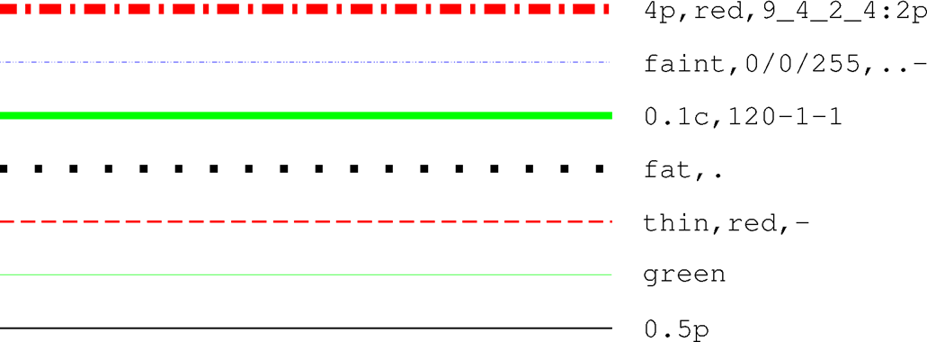
Specifying pen attributes, cont.
The offset phase-shifts the pattern from the beginning the line.
If you want a yellow line of width 0.1 cm that alternates between long dashes (4 points), an 8 point gap, then a 5 point dash, then another 8 point gap, with pattern offset by 2 points from the origin, specifying:
-W0.1c,yellow,4_8_5_8:2p
Additional examples of pen specifications

Slide 41
Specifying pen attributes, cont.
Several PostScript settings can affect the appearance of lines: Controlled via the GMT defaults settings PS_LINE_CAP, PS_LINE_JOIN, and PS_MITER_LIMIT in gmt.conf.
Determine how a line segment ending is rendered, be it at the termination of a solid line or at the end of all dashed line segments making up a line, and how a straight lines of finite thickness should behave when joined at a common point.
By default, line segments have rectangular ends, but this can change to give rounded ends.
Line appearance can be varied by using PS_LINE_CAP

Slide 42
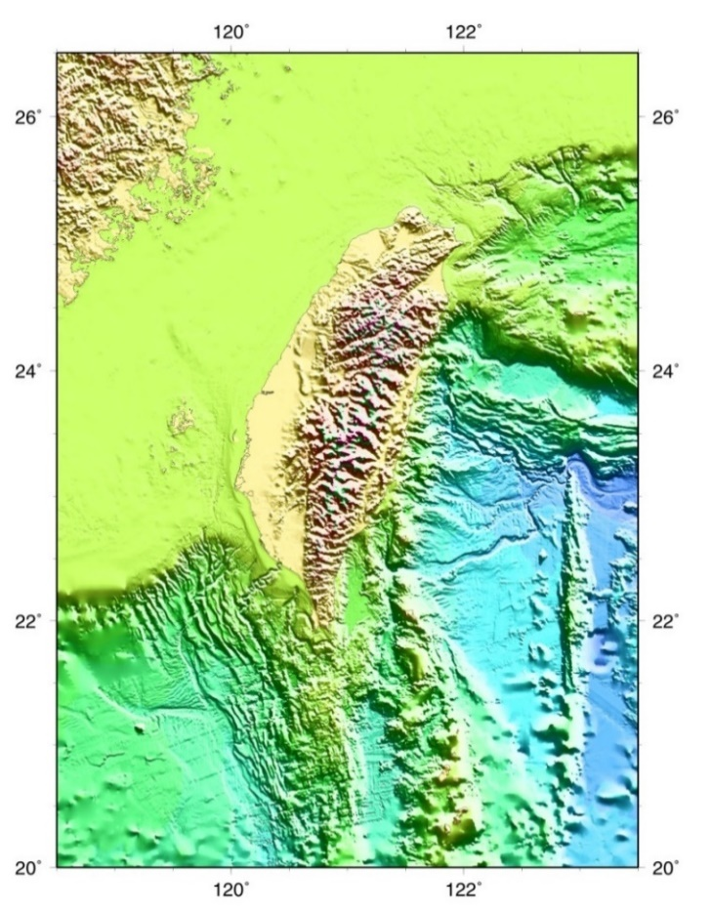

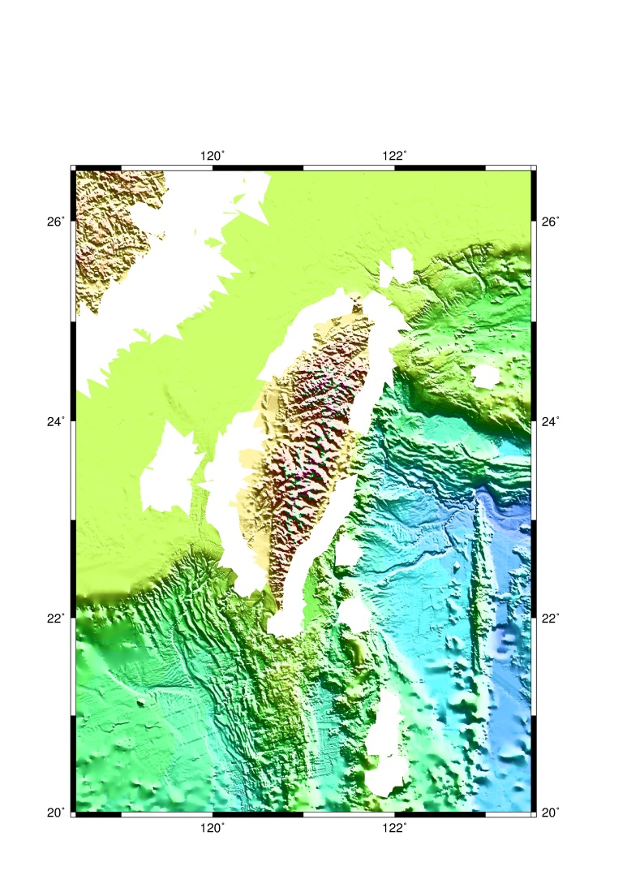
Draw shorelines
gmt coast -Dh -W0.8p,0/0/0 -V
Try: white outline with different widths & styles
-Wthick,white –W0.2p,255/255/255,. and –Wobese,white,-

Slide 43
Lect02B.bat
Lect02B.sh
set grd=c:\gridfiles\tw_topo500m.nc
set cpt=my1st.cpt
set range= 118.5/123.5/21/26
……
echo -5695.33 255 0 255 -5178.35 255 0 255 > my1st.cpt
echo -5178.35 113 0 255 -4068.62 113 0 255 >> my1st.cpt
…….
echo N 128 128 128 >> my1st.cpt
gmt begin %prefix% ps,png A+m0.5c
gmt grdgradient %grd% -A0/45 -G%int% -Ne0.6 -fg -V
gmt grdimage %grd% -Jm121/23/3c -R %range% -C%cpt% -I%int% -V
gmt coast -Df -Ba2f1 –W1p,black -Tdg122.5/25.5+w1.5+f2 ^
--MAP_FRAME_TYPE=fancy -V
gmt end
del %int%
grd=c:\gridfiles\tw_topo500m.nc
cpt=my1st.cpt
range= 118.5/123.5/21/26
……
cat << END > my1st.cpt
-5695.33 255 0 255 -5178.35 55 0 255
-5178.35 113 0 255 -4068.62 113 0 255
……
END
gmt begin ${prefix} ps,png A+m0.5c
gmt grdgradient ${grid} -A0/45 –G${int} -Ne0.6 -fg -V
gmt grdimage ${grd} -Jm121/23/3c –R ${range} –C${cpt} -I${int} -V
gmt coast -Df -Ba2f1 –W1p,black -Tdg122.5/25.5+w1.5+f2 \
--MAP_FRAME_TYPE=fancy –V
gmt end

Slide 44
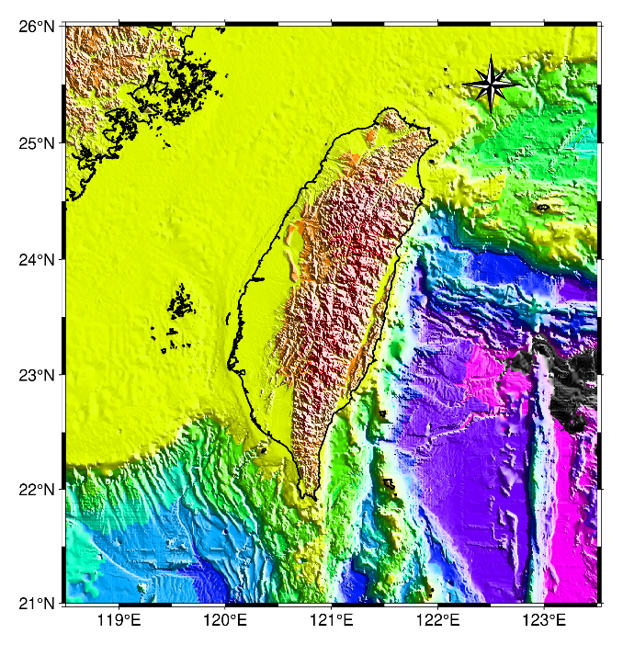
Lect02B.bat
echo -5695.33 255 0 255 -5178.35 255 0 255 > my1st.cpt
echo -5178.35 113 0 255 -4068.62 113 0 255 >> my1st.cpt
…….
echo F 255 255 255 >> my1st.cpt
echo N 128 128 128 >> my1st.cpt
gmt grdgradient %grd% -A0/45 - G%int% -Ne0.6 –fg
gmt grdimage %grd% –Jm3c -R118.5/123.5/20/26.5 -Cmy1st.cpt -I%int% -V
gmt coast -Df -Ba2f1 –W1p,black -Tdg122.5/25.5+w1.5+f2 ^
--MAP_FRAME_TYPE=fancy –V
在批次檔中可以用echo指令製作色階檔(my1st.cpt)
在my1st.cpt完整的色階檔中，可以定義前景(F)、背景(B)和非數(N, Not a Number)的顏色
Nota bene:在批次檔中，若使用的參數選項很多，造成指令列過長，可用換行符號^ (caret, 插入符號、脫字符)，告訴電腦進行換行。若在Linux和Mac OS的shell脚本中，則使用\ (backslash, 反斜線)換行。

Slide 45
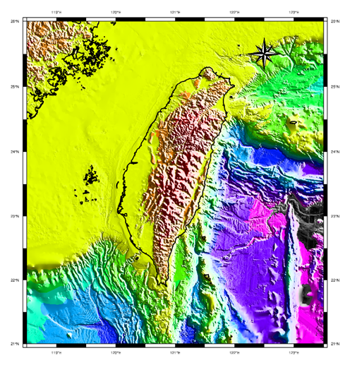
Lect02B.sh
echo Making color pallet table file,
cat << END > my1st.cpt
-5695.33 255 0 255 -5178.35 255 0 255
-5178.35 113 0 255 -4068.62 113 0 255
-----
-B 0 0 0
F 255 255 255
N 128 128 128
END
在shell脚本中，可以用cat指令製作色階檔(my1st.cpt)
cat (concatenate, 連結、連鎖): 指令會讀取所給予檔案的內容，並將其內容作標準輸出。將由檔案或標準輸入讀取的資料連結起來，並在標準輸出顯示結果，範例中輸出至檔案my1st.cpt 。
<<：指定結束符號，範例為END
直到最後一行為「END」才直接結束標準輸入
> ：覆蓋已經存在的檔名。

Slide 46
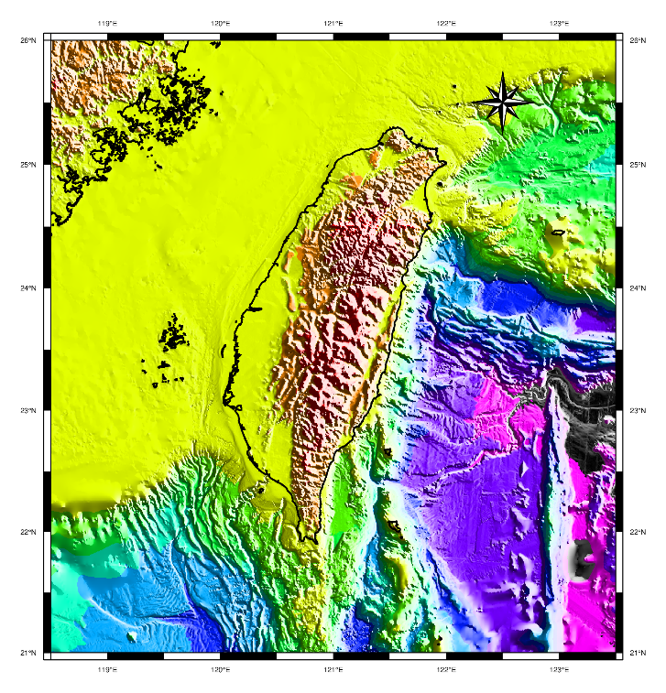
Map directional rose on the map
gmt coast -Df -Ba2f1 –W1p,black -Tdg122.5/25.5+w1.5+f2 ^ --MAP_FRAME_TYPE=fancy –V
Q: Why no basemap command used for base map?
A: gmt coast with –B could make base map
Td[g|j|J|n|x]refpoint+wwidth[+f[level]][+jjustify][+lw,e,s,n][+odx[/dy]]:方向玫瑰圖
g: map coordinates (地圖坐標)
refpoint: reference and anchor points (位置参考點和錨定點，範例為錨定點經度/錨定點緯度
+l:在方向標頂點標上W,E,S,N
+w: set the width of the rose in plot coordinates (in inches, cm, or points)(設定方向玫瑰圖寬度)
+f/level: get a “fancy” rose, and specify in level what you want drawn (level 1,只有E-W, N-S，2多標出NW-SE &NE-SW, 3則有16個方位)

Slide 47
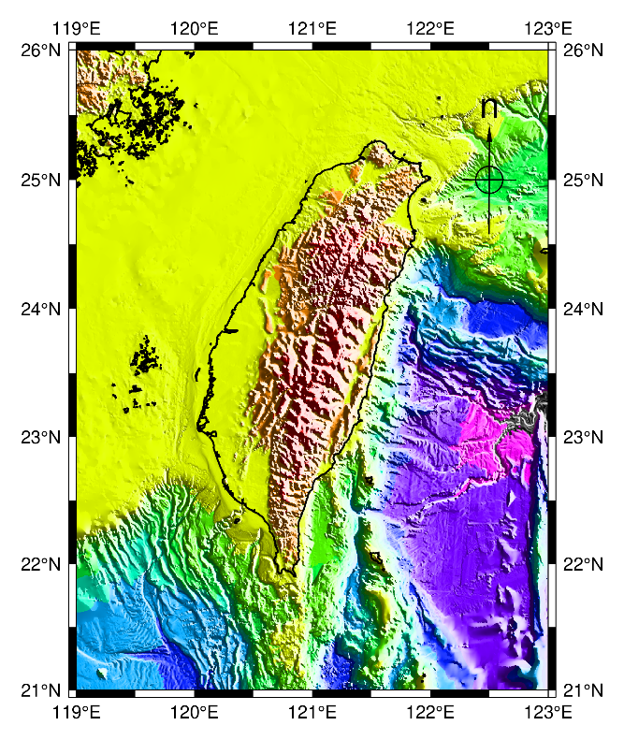
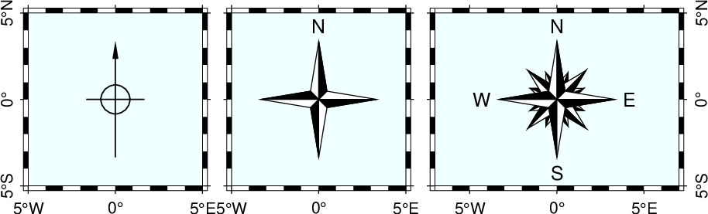
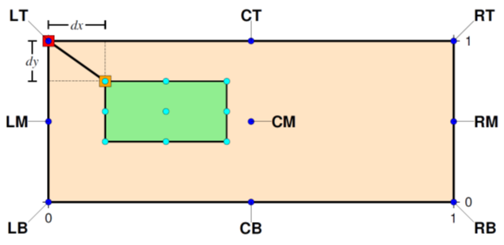
gmt coast -Df -Ba2f1 –W1p,black -Tdg122.5/25.5+w1.5+f2 ^ --MAP_FRAME_TYPE=fancy –V
Td[g|j|J|n|x]refpoint+wwidth[+f[level]][+jjustify][+lw,e,s,n][+odx[/dy]]:方向玫瑰圖
+j: followed by a 2-char justification code justify (用兩個字母指定方向玫瑰圖上的錨點)
+o:offset the color scale by dx/dy away from the refpoint in the direction implied by justify (在參考點的基礎上，調整方向玫瑰圖的額外偏移量)
1. -Tdg122.5/25+w1i+lw,e,s,n
2. -Tdg122.5/25+w1i+lw,e,s,n+f1
3. -Tdg122.5/25+w1i+f3
Change level of direction rose

Slide 48

Lect02C
set cpt=topo_sealand.cpt
set int=tw_topo500m.nc.int
set range=118.5/123.5/20/26.5
gmt grdgradient %grd% -A115 -G %int% –Ne0.8 –fg
gmt grdimage %grd% –Jm1.2i -R %range% -C%cpt% -I%int% -Y6c -V
gmt coast -R -Jm -Df -Ia/1p,blue -Lg122/26+c23+w200k+l+f -Ba1f0.5 -W3 -V
gmt colorbar -Dx0.2c/-1.5c+w-15c/0.4c+h -C%cpt% -Bxf200a1000 -I -V
-I: Draw rivers (畫河流)
-L: Draw a simple map scale (畫比例尺)
colorbar: Plot a gray or color scale-bar on maps (畫灰階或彩色之色彩條)

Slide 49
Draw rivers
gmt coast -Df -Ia/1p,blue -Lg122/26+c23+w200k+l+f -Ba1f0.5 -W3 -V
-Iriver[/pen]: Draw rivers
0 = Double-lined rivers (river-lakes)
1 = Permanent major rivers
2 = Additional major rivers
3 = Additional rivers
…..
10 = Irrigation canals
You can also choose from several reconfigured river groups:
a = All rivers and canals (0-10)
A = All rivers and canals except river-lakes (1-10)
r = All permanent rivers (0-4)
R = All permanent rivers except river-lakes (1-4)
…..

Slide 50
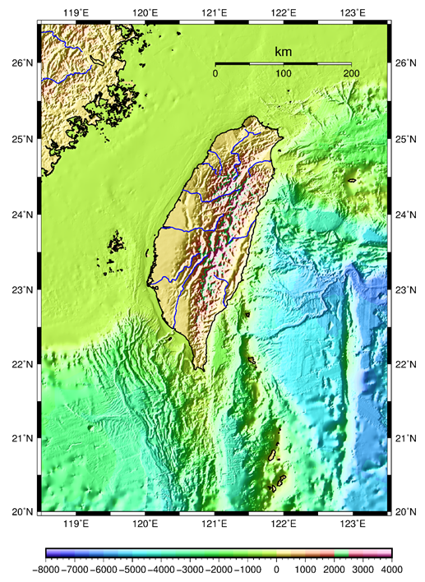
Draws a simple map scale
gmt coast -Df -Ia/1p,blue -Lg122/26+c23+w200k+l+f -Ba1f0.5 -W3 -P -V
L[g|j|J|n|x]refpoint+c[slon/]slat+wlength[e|f|k|M|n|u][+aalign][+f][+jjustify][+l[label]][+odx[/dy]][+u]
-Lg: for map coordinates (地圖座標位參考點)
refpoint:参考點和錨定點
+c: Scale is calculated at latitude slat [Default is central meridian]
+w: Length is in km
+f: get a “fancy” scale [Default is plain].
+l: select the default label which equals the distance unit
+jjustification: choose among l(eft), r(ight), t(op), and b(ottom).
+u: append the unit to all distance annotations along the scale

Slide 51
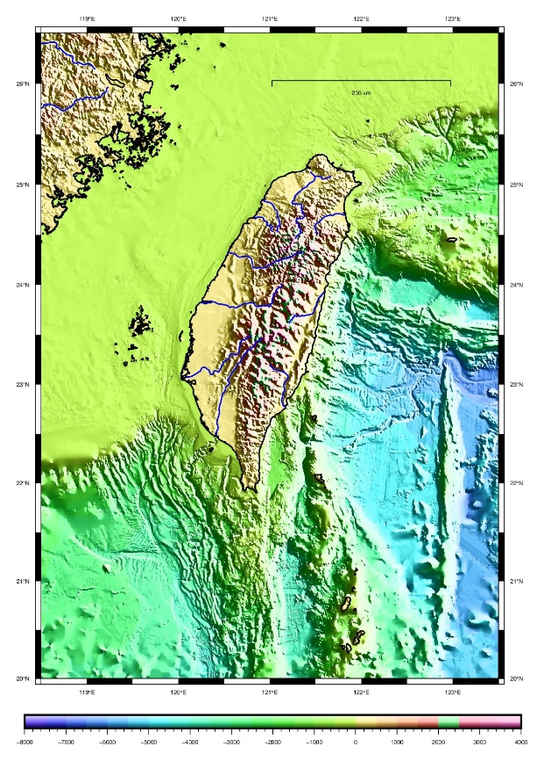
Draws a simple map scale
gmt set FONT_LABEL=16p,Helvetica,black FONT_ANNOT_PRIMARY=12p,Helvetica,black ^
MAP_SCALE_HEIGHT=8p MAP_TICK_PEN_PRIMARY=thinner,black
Please try:
上列GMT配置參數可以控制比例尺的外觀及標注字體
-Lg122/26+c23+w200k+l
-Lg122/26+c23+w200k+l+f+jr
-Lg122/26+c23+w200k+l+f+u

Slide 52
gmt colorbar (繪製色彩條)
colorbar [-B[p|s]parameters ] [ -Ccpt ] [ -Drefpoint ] [ -Fpanel ] [ -Gzlo/zhi ] [ -I[max_intens|low_i/high_i] ] [ -Jparameters ] [ -Jz|Zparameters ] [ -L[i][gap] ] [ -M ] [ -N[p|dpi ]] [ -Q ] [ -Rregion ] [ -S ] [ -U[stamp] ] [ -V[level] ] [ -Wscale ] [ -X[a|c|f|r][xshift[u]] ] [ -Y[a|c|f|r][yshift[u]] [ -Zzfile ] [ -pflags ] [ -ttransp ] [ --PAR=value ]
調整色彩條的位置: -D[g|j|J|n|x]refpoint+wlength/width[+e[b|f][length]][+h]
[+jjustify][+m[a|c|l|u]][+n[txt]][+odx[/dy]]:
-Dx: 參考點X位置/Y位置
+w: length and width of the color bar. Give a negative length to reverse the scale bar. (色彩條長度和寬度，長度值為負值，顛倒色階)
+h: get a horizontal scale [Default is vertical]. (改成水平色彩條，預設為垂直色彩條)

Slide 53
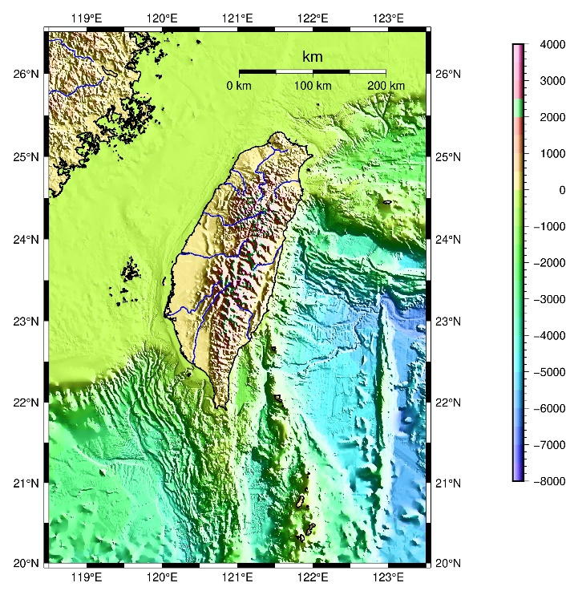
gmt colorbar (繪製色彩條)
gmt colorbar –Dx-0.5c/-1.5c+w15c/0.4c+h -C%cpt% -Bf200a1000 -I -V
-I[max_intens|low_i/high_i]: Add illumination effects. (開啟照明效果)
Set the range of intensities from - to + max_intens. If not specified, 1 is used.
Please try:
–Dx17c/3c+w16c/0.4c
-Dx-0.5c/-1.5c+w-15c/0.4c+h –I0.5

Slide 54
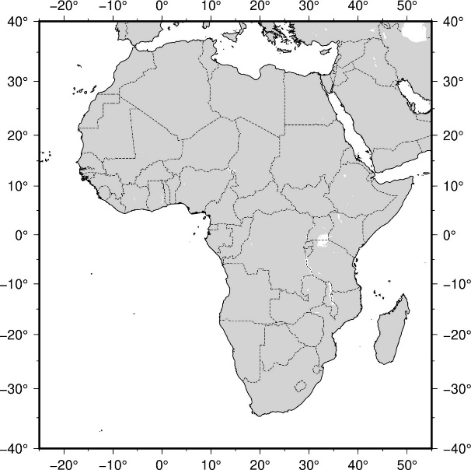
Exercise 02
Topography and Bathymetry in and around Africa
Using Global etopo2.nc and topo_relief.cpt to draw the relief of Africa
Open Ex02.bat or Ex02.sh
gmt grdcut earth_relief_02m.nc –Gafrica.nc -R-25/55/-40/40
gmt coast -R-25/55/-40/40 -Jm15/0/0.06i -Ba10f5 -N1/0.25p,- -W1/0.5p,black -V
1. GMT commands include grdinfo, grdgradient, grdimage, coast and colorbar
2. Add a map directional rose with coast -Td flag.
3. Using Lect02C.bat or Lect02C.sh as an example, try to imitate how to modify the gmt module and options.
4. Using earth_relief_02m.nc as an input file, topo_relief.cpt as a cptfile
5. Using -I to draw the major rivers
Nota bene:為增加執行效率，將全球資料earth_relief_02m.nc利用grdcut指令裁剪成繪圖範圍，-G輸出新檔名，新的網格檔為africa.nc，-R裁剪範圍。
Nota bene:在陸地和海洋區域，填進數值高程，則原指令中-G或-S選項不必再使用，否則會蓋住地形。

Slide 55
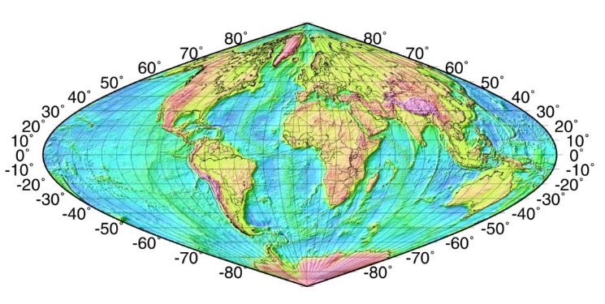
Homework 02
Using global 5 minutes grid file (earth_relief_05m.nc) to draw the global relief or 1 minutes grid file earth_relief_01m.nc to draw the non-global relief with different projection based on assigned examples by TA. Suggestion: first using grdcut to cut the region in your assigned example.
2. Assigned examples (Cookbook,先瀏覽，可自選或由助教指，但不可重覆)
file:///C:/programs/gmt6/share/doc/html/cookbook/map_projections.html):
3. Using grdinfo to extract the information of earth_relief_05m.nc or earth_relief_01m.nc
4. Using topo_sealand.cpt as a cptfile
5. A winword file (max. 2 pages) for detailed description of map projection & -Jparameters with arguments and flags of assigned homework (Map projection, see website: https://en.wikipedia.org/wiki/Map_projection#Notable_lines)
Nota bene:找到指定範例後將指令複製至Text Editor中，使用Windows系統的人，請先將\改成^，存檔後執行，確認可畫出範例圖後，再填入數值高程。

Slide 56
Assignments
GMT cookbook: file:///C:/programs/gmt6/share/doc/html/cookbook.html
13. Color Space: The Final Frontier
16. Of Colors and Color Legends
Manual html: C:\programs\gmt6\share\doc\html
grdinfo.html
grdgradient.html, Arguments –A, –N and -fg
grdimage.html, Arguments –C and -I
coast.html, Arguments –I, –N, -L and -D
colorbar.html, Arguments –D and -I
basemap.html

